Slide 1
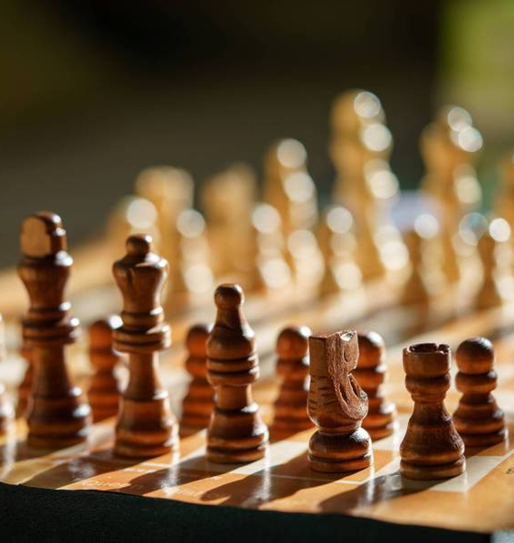
TLC Quantum Chess
Fontys
TU/E

Slide 2
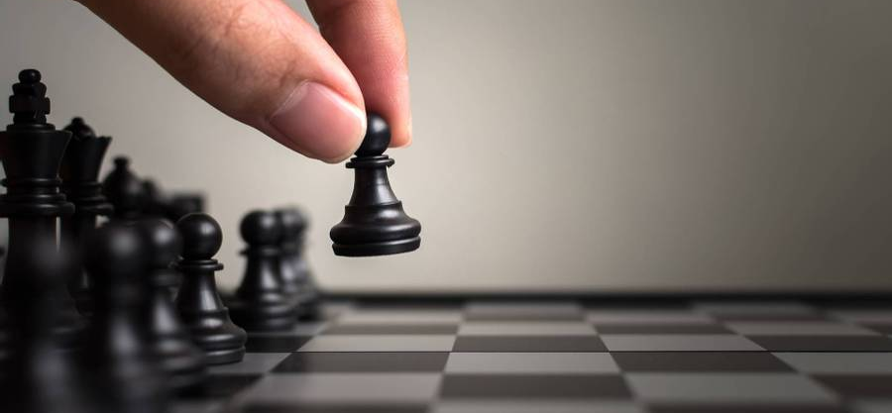

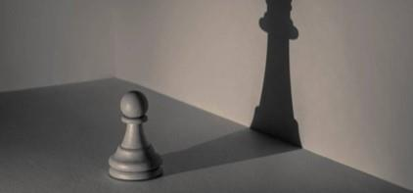
Agenda
Introduction
Recap
Functionalities
Prototype wireframes
Questions
Meetings

Slide 3
Team
Genelle Geerman – Scrum Master
Maike Meek – Contact Person
Lucas Jacobs – Back-end Lead
Esther Wolfs – Git Master
Gabriela Hristova – Front-end Lead

Slide 4
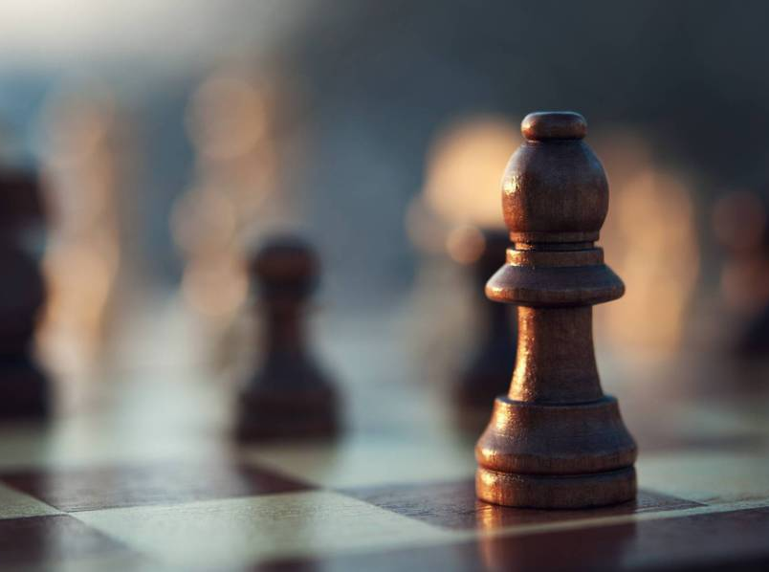
Recap
Web application where you can participate in tournaments and play quantum chess

Slide 5


Prototype functionalities

Slide 6
Tournament functionalities
View tournaments ongoing
See upcoming tournaments
View overview/score tournament
See a scoreboard

Slide 7
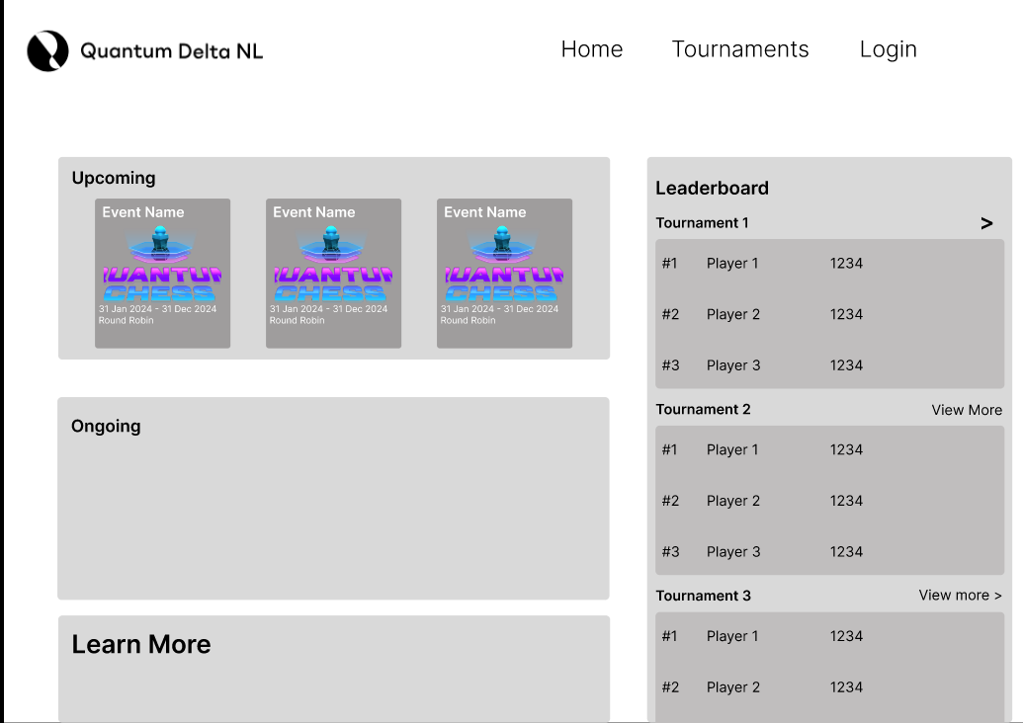
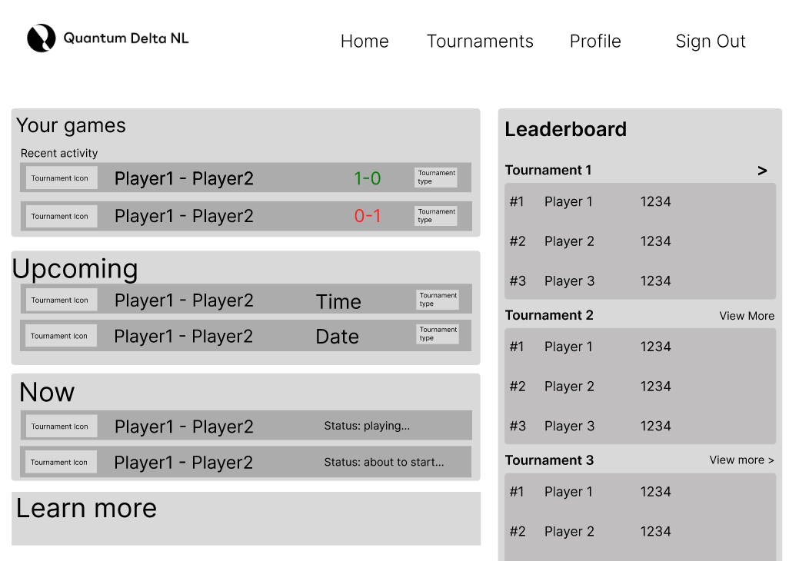
Home screen

Slide 8
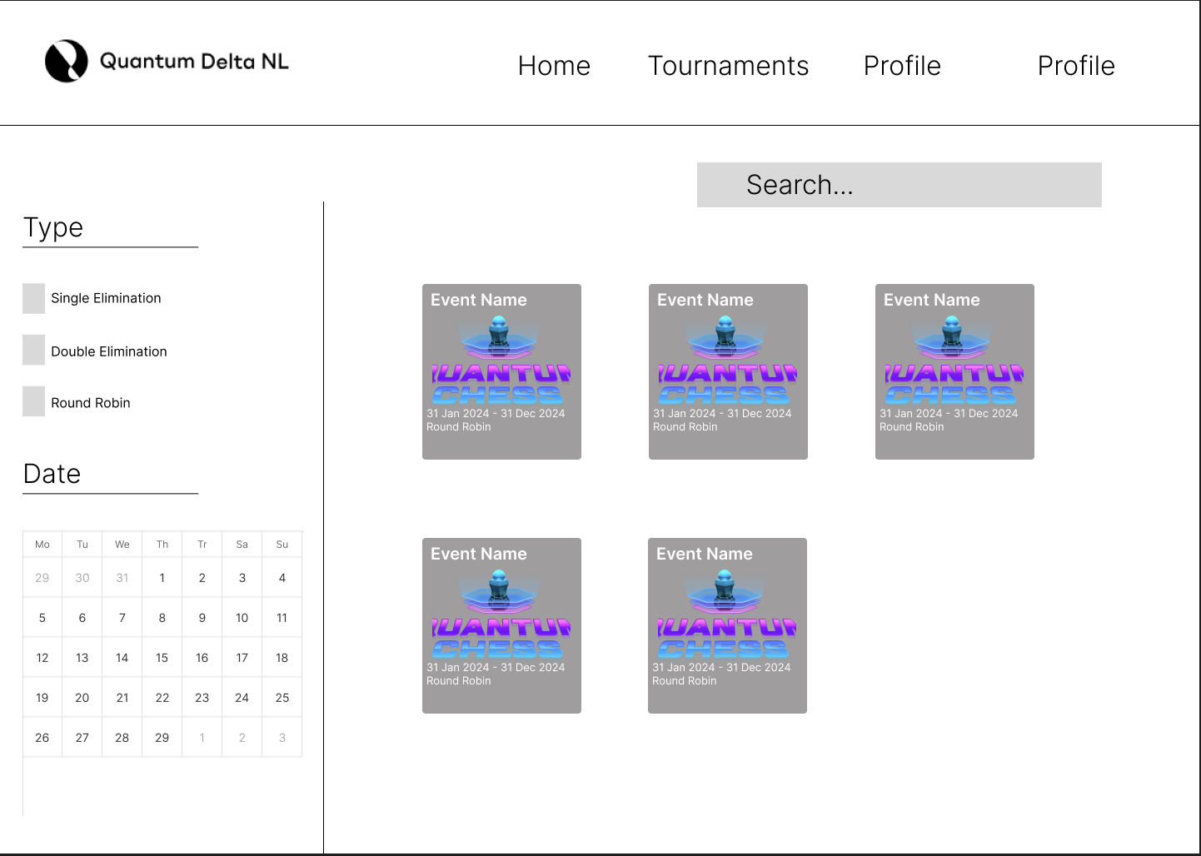
Tournament page

Slide 9
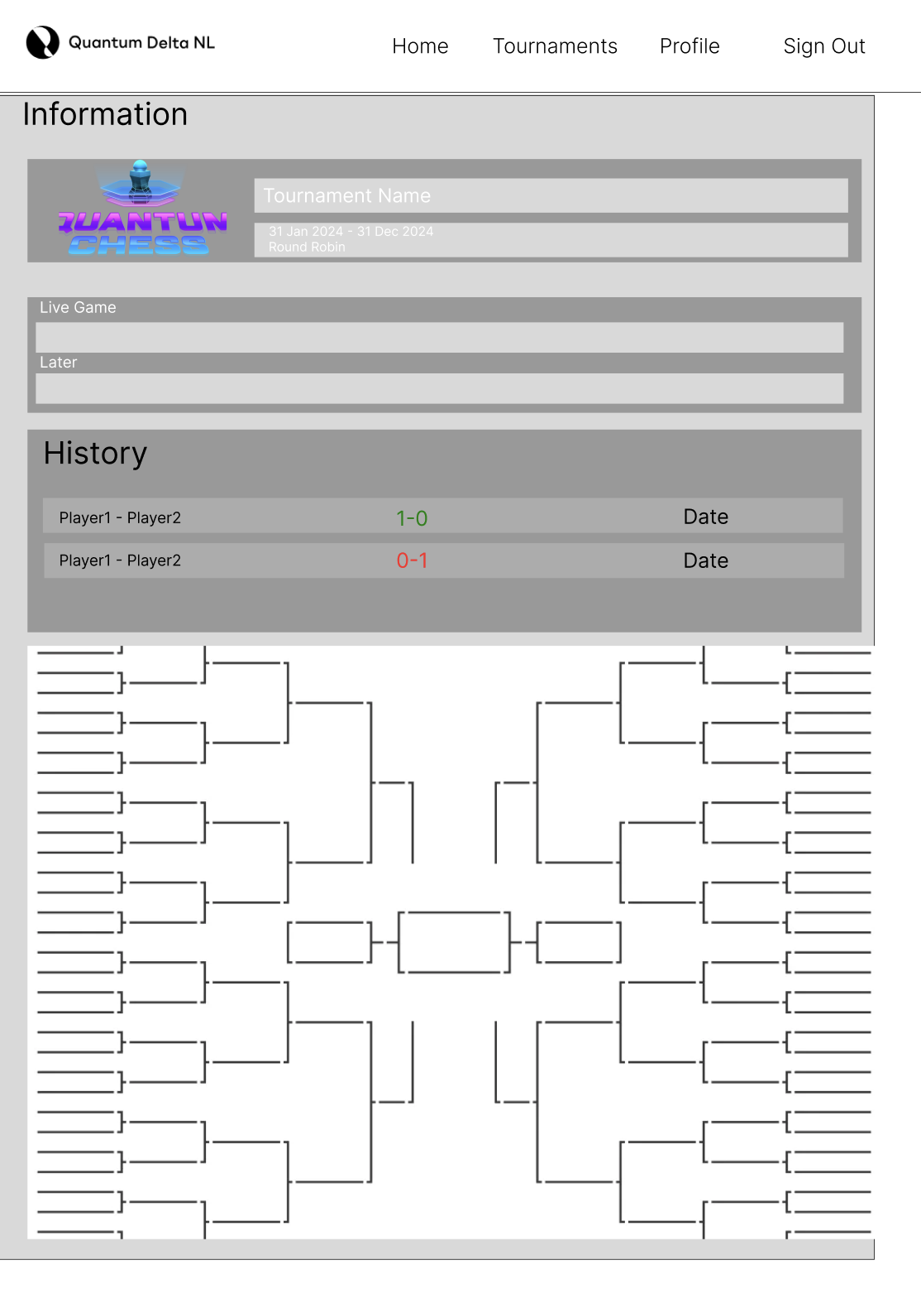
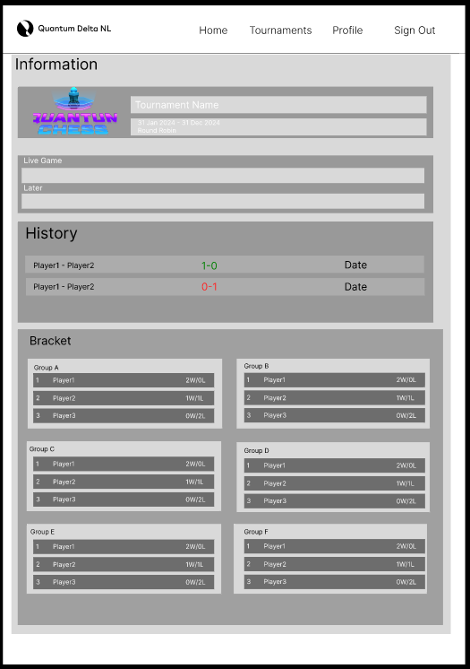
Tournament page

Slide 10
Profile Functionalities
Login
Register
Notification settings
Edit personal information
See your history game/tournaments
Settings
Change language
Change color design
Admin
Add tournament
View users
Edit users
Edit tournaments
Add organizations

Slide 11
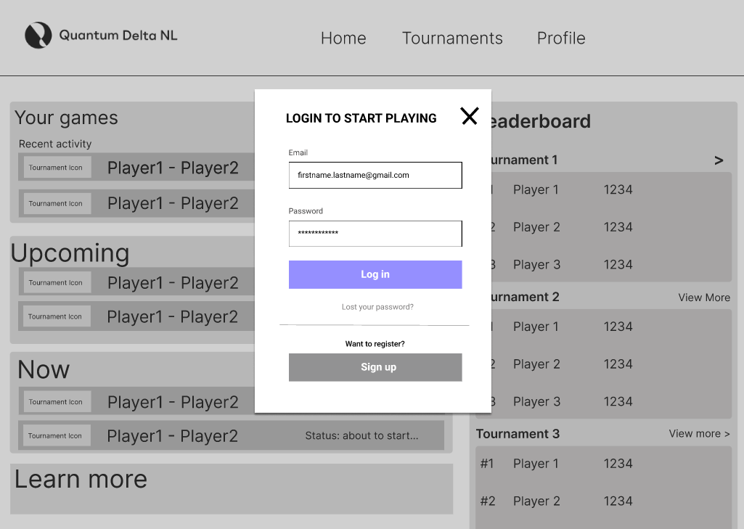
Login

Slide 12
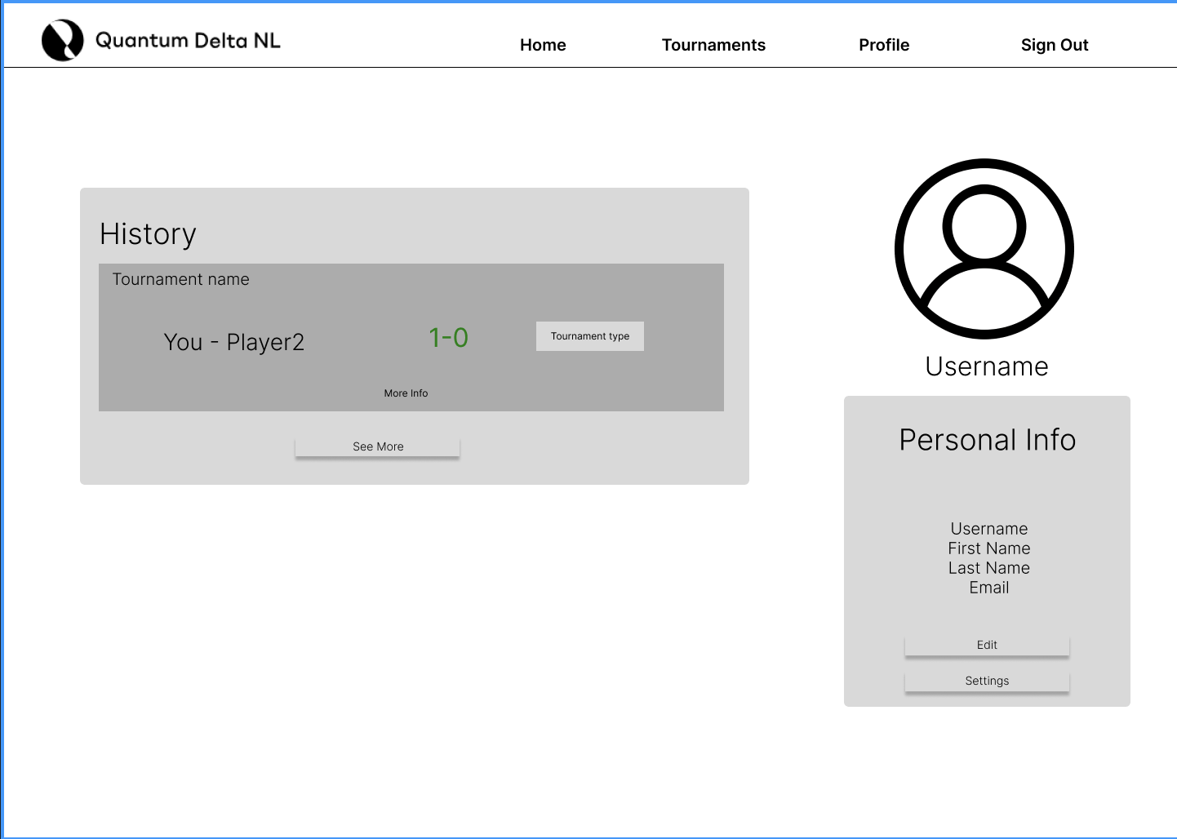
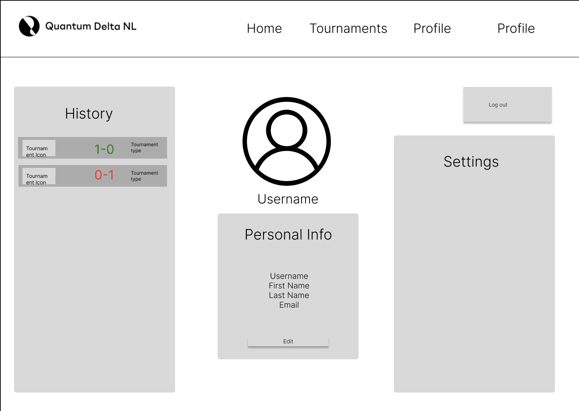
Profile page

Slide 13
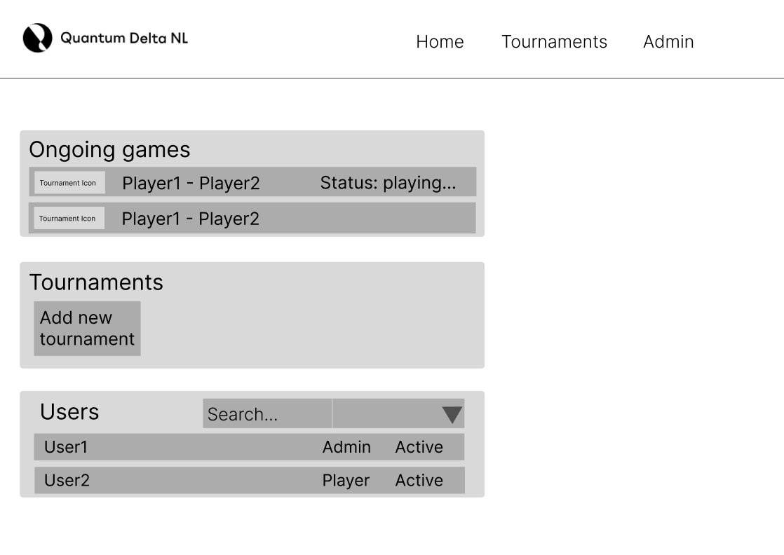
Admin page

Slide 14
In Game Functionalities
Play the game
See all the previous moves
Chat with the opponent
See how the tournament in general is going
Spectate the game

Slide 15
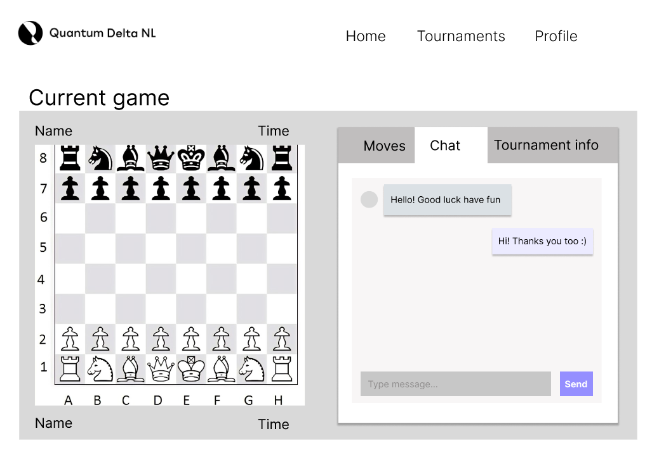
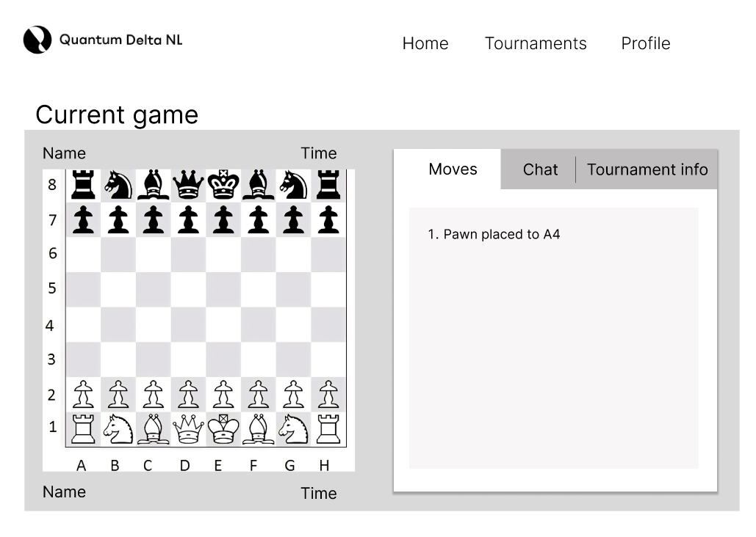
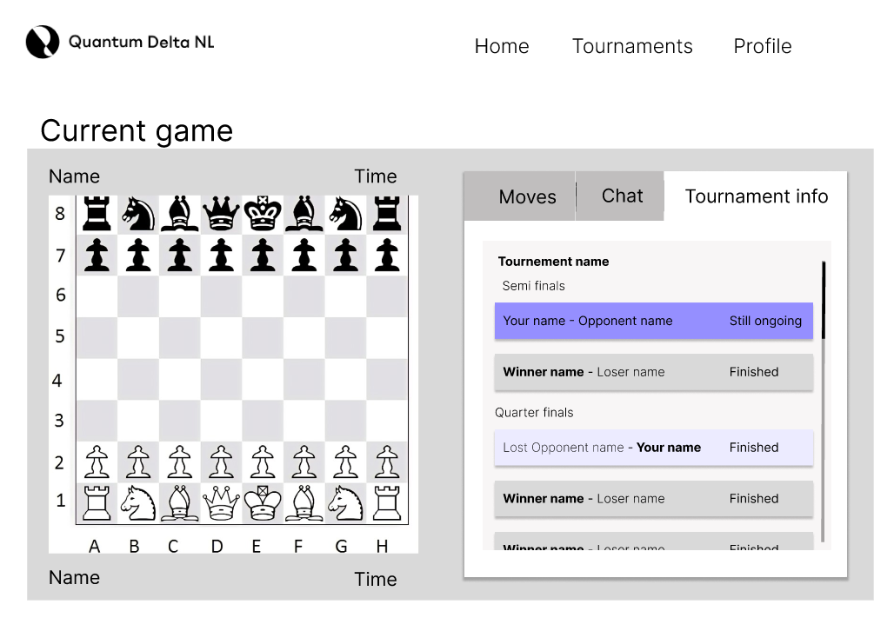
In game

Slide 16
Our questions
Functionalities
Size tournaments
Application types
User types
Cheating
Meetings
Demo’s

Slide 17
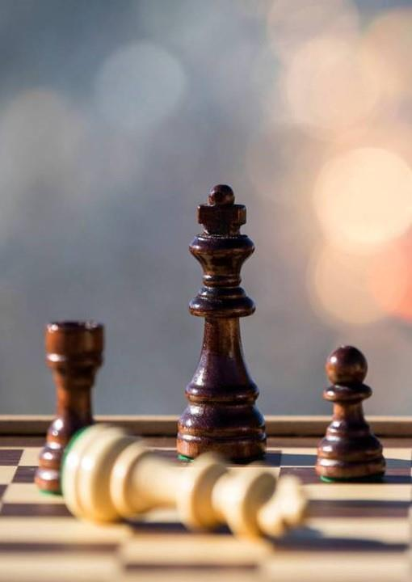
Thank You

